Slide 1
Line Functions and Parameters
Mack 2021

Slide 2
Overview
In this learning activity students will create a visual composition using the p5 shape-drawing functions (point, line). They will be introduced to functions parameters and then call them in p5.

Slide 3
Objectives
Students will be able to:
Understand the p5 canvas coordinate system
Consult the p5 reference for documentation
Create a line and point
Change the grayscale value of a canvas
Use lines to create a rectangle or a house

Slide 4
p5.js web editor overview
The p5 alpha editor is a web based code editor that has the p5 library already added to the development environment. It is an integrated development environment or IDE. And IDE is a piece of software that allows a developer to write code and execute the code within one interface, and may have other features like debugging.

Slide 5
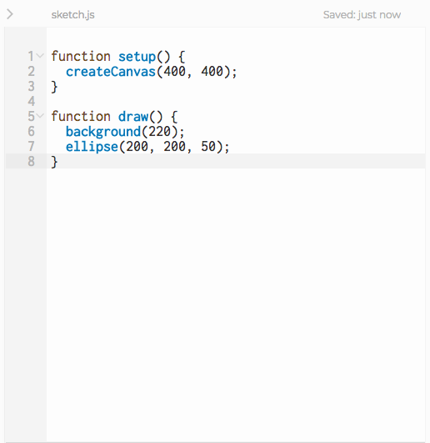
p5.js web editor overview
The code editor will by default open to the file sketch.js, which is where the main p5 program is written. This is the text editor window.
Notes:
When creating a new sketch, it will populate the file with some basic starter code. This window can be used like a typical text editor.

Slide 6
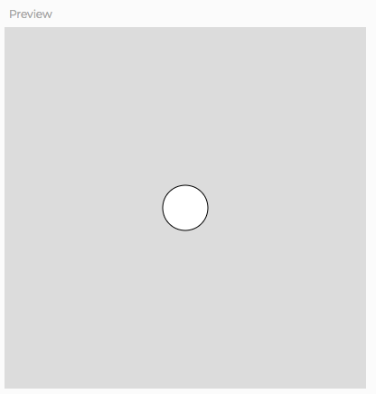
p5.js web editor overview
To the right of the text editor is the Preview window. This is actually a window with the website being created in the editor embedded inside of it. When the sketch is executed the result will appear in the preview window.

Slide 7
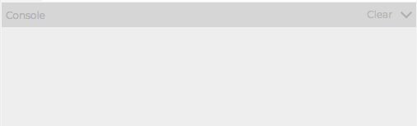
p5.js web editor overview
Below the editor is the Console window. The console is an interface that prints information such as errors, warning and developer logs for the developer to view as they are working on a project.

Slide 8

p5.js web editor overview
Directly above the text editor are some essential interactive interfaces.
Notes:
The big play button with run the sketch. The stop button will stop running the sketch. The auto-refresh option will execute the sketch as the code is updated (I don't recommend this setting in its current version). The title of the sketch has a pencil icon next to it which can be clicked to change the sketch name.
The sketch can also be run by hitting Command + Enter on the Mac keyboard and stopped with Command + Shift + Enter. On Windows the key commands are the same except Control replaces Command.

Slide 9
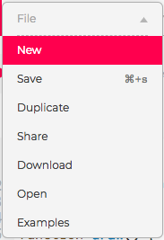
p5.js web editor overview
The toolbar is at the top of the window. The first menu, File, allows the user to save the current sketch, open a previously saved sketch, open an example from the p5 set of example, duplicate a saved sketch, share a sketch or download the files from a sketch. Some of these functions will be covered in greater depth in future lessons.
Notes:
Command + S on the Mac can also be used to save a sketch.

Slide 10
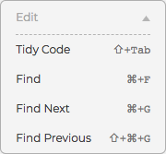
p5.js web editor overview
The Edit section can be used to Tidy Code, or update the code formatting. Tidy Code is a very useful feature for new students who haven't mastered code formatting, adding indentations and curly brackets and other mistakes. Tidy Code also has a key command, Shift + Tab. Encourage students to use this function frequently.

Slide 11
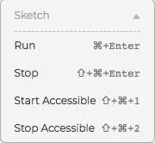
p5.js web editor overview
The Sketch menu has options to run the sketch, stop the sketch and start and stop Accessibility enabled versions of the sketch.

Slide 12
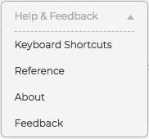
p5.js web editor overview
Finally the Help & Feedback menu includes a complete list of the keyboard shortcuts and, a link to the p5 reference, which students should use as often as possible.

Slide 13
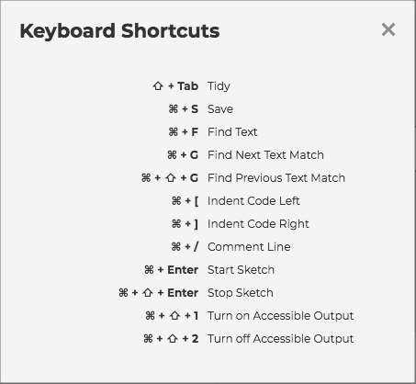

Slide 14
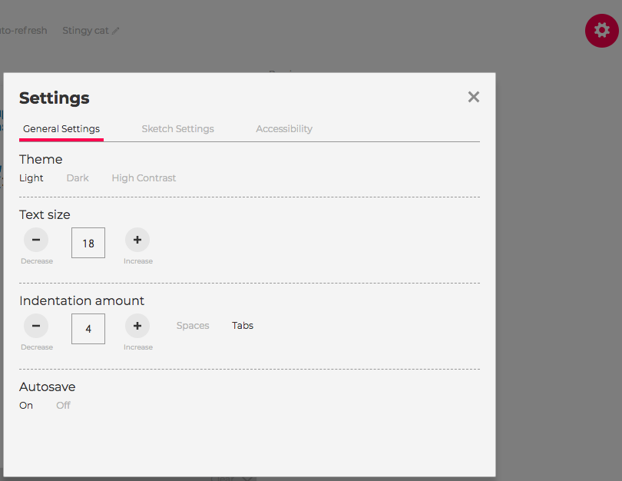
Customize View
As well as a settings button that opens a menu for visual settings, such as the color theme and font size of the editor.

Slide 15
createCanvas() and background()
Code is just a set of instructions for the computer. In order to give instructions to p5, we'll need to use different functions and change their parameters to fit our desired output.

Slide 16
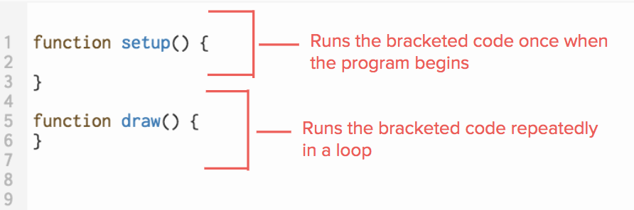
Functions
Functions are lines of code that perform specific tasks. Two functions are automatically added to your sketch when you open the editor.

Slide 17
Functions
While setup and draw are defined by the developer in each sketch, most of the p5 functions we'll use are defined by the p5 library, and invoked in our code.

Slide 18
Functions
When a function is invoked, or called, the programmer is asking the program to run the code within the function. The parenthesis operator is used to invoke the function.
Ex. rect(50, 50, 100, 100);

Slide 19
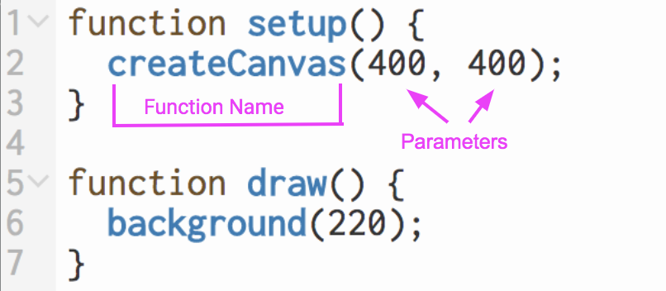
Functions
The values inside of the parentheses are known as arguments or parameters. These are used to change the outcome of a function.

Slide 20
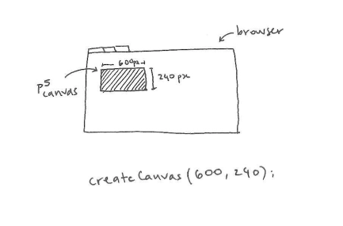
createCanvas() function
This function creates a p5.js canvas.
The canvas is an element on the web page on which we will draw our graphics.
Syntax: createCanvas(width, height)

Slide 21
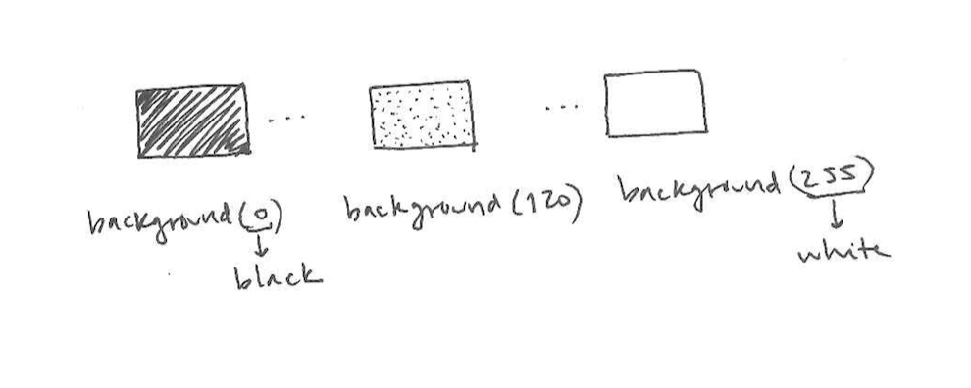
background() function
This function gives our canvas a background grayscale color between 0 (black) and 255 (white)
Syntax: background(value)
Notes:
What happens when if you were to add multiple background functions with different values? Which of background color is prioritized? Why?

Slide 22
Line and point function | Student Code Along
To draw on the canvas, call p5.js functions like point() and line().
A point is defined by an (x, y) coordinate.
A line is defined by its start and end points.

Slide 23
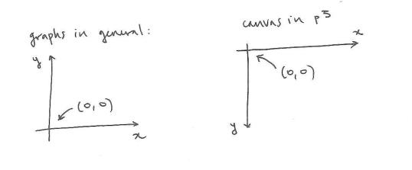
Line and point function | Student Code Along

Slide 24
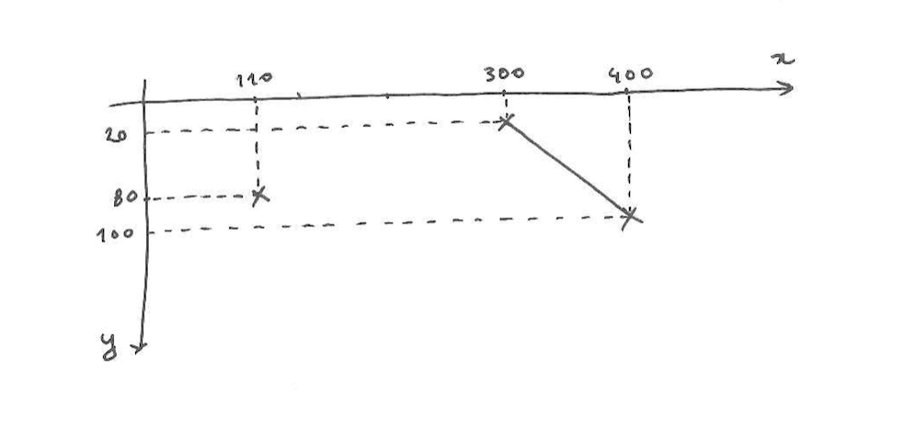
Line and point function | Student Code Along

Slide 25

Line and point function | Student Code Along
point(x,y)- The function name to draw a point is "point". The parameters are (x,y) which are the x and y coordinates.
line(x1,y1,x2,y2)- The function name to draw a line is "line." The first x and y are the starting point and and the second are the end point.

Slide 26
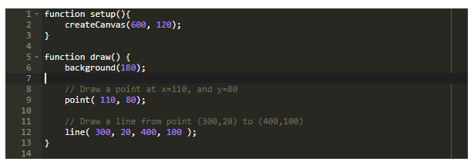
Code

Slide 27
Comments
As you can see, the lines with a '//' before them are grayed out. These are comments. You can use them as notes to yourself: they are ignored by the interpreter that runs the program, so they will not affect how it works.
If your program does not behave as you expect, it is useful to turn off lines of code one by one by 'commenting them out' (adding '//' to them). This will help you determine which one is causing the problem.
Programmers add comments to their code as notes to themselves or others who might be reading it.
Commenting code is excellent practice and should be constantly encouraged.

Slide 28
Practice
Draw a point near the top-right corner of the canvas.
Draw a point in the middle of the canvas.
Draw a point near the bottom-left.
Draw a horizontal line, a vertical line, a diagonal line.
Draw a line from the top-left corner to the bottom-right corner.
Try this out...

Slide 29
Extension
Use multiple line functions to create a rectangle and a triangle so the lines create a house (pentagon).
Add comments for each line position.
Looking for something harder?

